Slide 1
Applied data science
Fall 2018 section 1 project 3 group 6

Slide 2
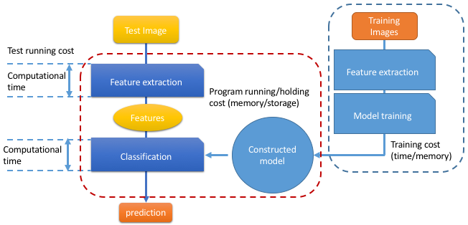
Model dev introduction

Slide 3
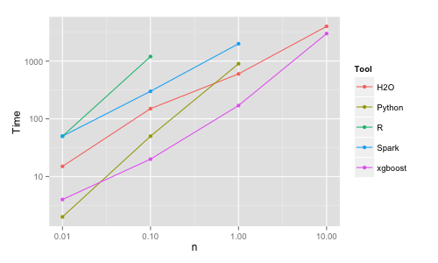
WHY Xgboost?
1:Parallelization
2:Distributed Computing
3:Out-of-Core Computing
4:Cache Optimization
Notes:
Parallelization of tree construction using all of your CPU cores during training.
Distributed Computing for training very large models using a cluster of machines.
Out-of-Core Computing for very large datasets that don’t fit into memory.
Cache Optimization of data structures and algorithm to make best use of hardware.
Graph is Benchmark Performance of XGBoost,taken from Benchmarking Random Forest Implementations

Slide 4
Model comparison
XGboost
max_depth = c(4,6,8)
eta = c(0.1,0.3,0.5)
subsample = c(0.5,0.8)
min_child_weight = c(4,6,8)
Baseline
depth = c(11,13)
n.trees = c(250,300)

Slide 5
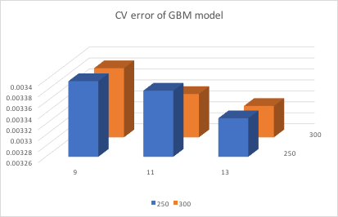
Visualization of Baseline CV error
No. of trees: 250, 300;
No. of depth: 9,11,13

Slide 6
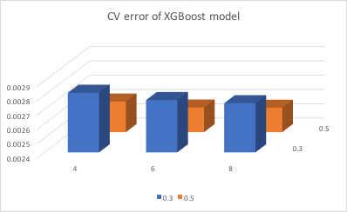
Visualization of XGBoost CV error
No. of max_depth: 4, 6, 8;
Eta: 0.3, 0.5
With subsample=0.8, min_child_weight=8.

Slide 7
Baseline
XGBoost
Running time for CV: 5 hours
Running time for training: 6 mins
Running time for CV: 40+ hours
Running time for training:5+ hours

Slide 8
Parallelized parts:
Training of GBM model: 3 times faster
Training of XGBoost model
Super-resolution: 6 times faster

Slide 9
Thank you!
Q&A

